Slide 1
Project Proposal: Enterprise Network Design and Implementation Using Huawei Datacom
Team Members:
Marwan El-Khatib Abd El-Wares 21067890
Muhammad Hussam Abd Elazim 21067772
Roba Walaa El-din Ahmed 21035417
Zeinab khamis Elfewal 21016735
Afnan Ashraf Taha 21046133
Supervisor: Eng. Samah Eisa

Slide 2
Introduction
This project aims to design and implement an integrated, scalable, and flexible enterprise network using Huawei Datacom technologies. The proposal outlines the project's motivation, objectives, methodology, and expected outcomes.

Slide 3
Problem Statement
Modern organizations require robust, scalable, and secure network infrastructures that support daily operations, security, and future expansion. Many networks fail due to poor planning, limited scalability, lack of documentation, faulty of devices and cables, and poor security.

Slide 4
Objectives
Gain comprehensive practical experience
Build a complete, organized, and scalable network
Understand corporate network structure (Access, Aggregation, Core layers)
Enable integration of new technologies after deployment
Develop planning, documentation, and security skills
Implement enterprise-grade services (DHCP and Telnet)

Slide 5
Scope of Work
Layer 2: Switching (Core, Aggregation and Access switches, STP protocol, Link Aggregation, VLAN, INTER-VLAN)
Layer 3: Routing (Routers, OSPF, NAT)
security techniques: ACLs, AAA
Network Services: DHCP, Telnet
LAN, WAN & WLAN implementation

Slide 6
Methodology
Planning & Design: Topologies, Devices selection
Implementation: Configure switches and routers, and Implementing all necessary protocols, security requirements and services.
Testing & Verification: Connectivity, redundancy, security, performance
Documentation: Configurations, Topologies, guidelines

Slide 7
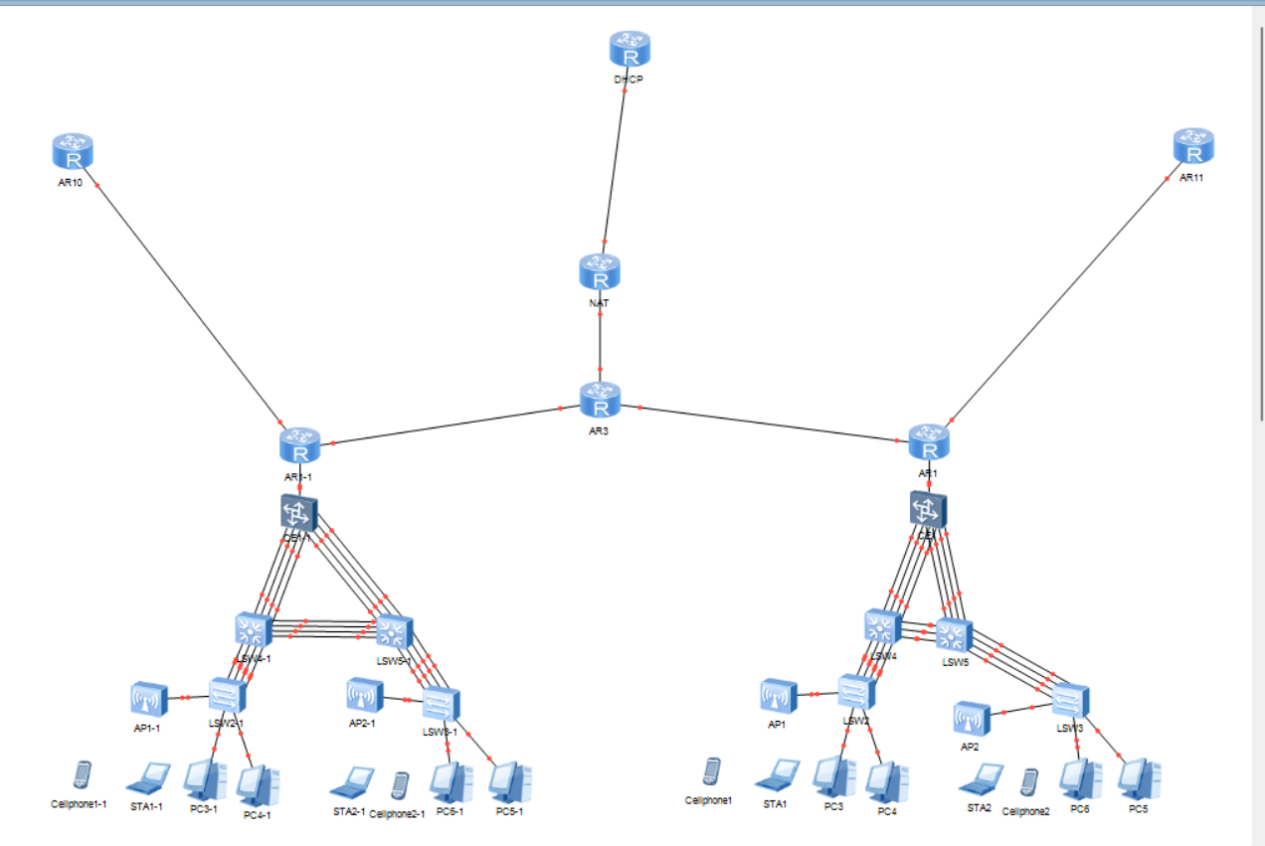

Slide 8
Expected Outcomes
Fully functioning enterprise-level network using Huawei Datacom
Enhanced understanding of network planning and implementation
Practical experience with security, routing, and switching
Scalable design that supports future technologies

Slide 9
Timeline
Planning & Design: Week 1 → Network diagrams and Topologies, requirements
Implementation: Week 2 → Configured network devices
Testing: Week 3 → Validation reports
Documentation: Week 4 → Final project report

Slide 10
Resources Required
Huawei Datacom devices and tools (Switches, Routers, PCs, ACs and Cables )
Network simulation tools ( eNSP )
Documentation software (Word, PowerPoint)

Slide 11
Conclusion
This project will provide hands-on experience in enterprise networking with Huawei Datacom, equipping the team with practical knowledge in planning, implementation, and security while ensuring scalability for future growth.

